Slide 1
NYC Visualizations
Team DAAL
David, Alexandre, Anmol and Lawson

Slide 2
Background
The idea of the project was to combine different NYC datasets in order to gain interesting insight
Focus on landscape and body of NYC, rather than just statistics and aggregates

Slide 3
Datasets
NYC Open Data
Centerline - NYC Street Data
NYC parking tickets
Parking Meters Dataset
Taxi trips
CitiBike data
Bike station dataset

Slide 4
Use of the Cloud
Spark, SparkSQL, SparkML
Spark and SparkSQL were used to do the bulk of computation in order to get the data we needed to visualize
Datasets of up to 60GB+ are obviously unreasonable to process locally

Slide 5
Centerline Dataset
Information about every street in NYC
100,000+ Data points:
Street name
House number range
Geometry of the road
Latitude
Longitude

Slide 6
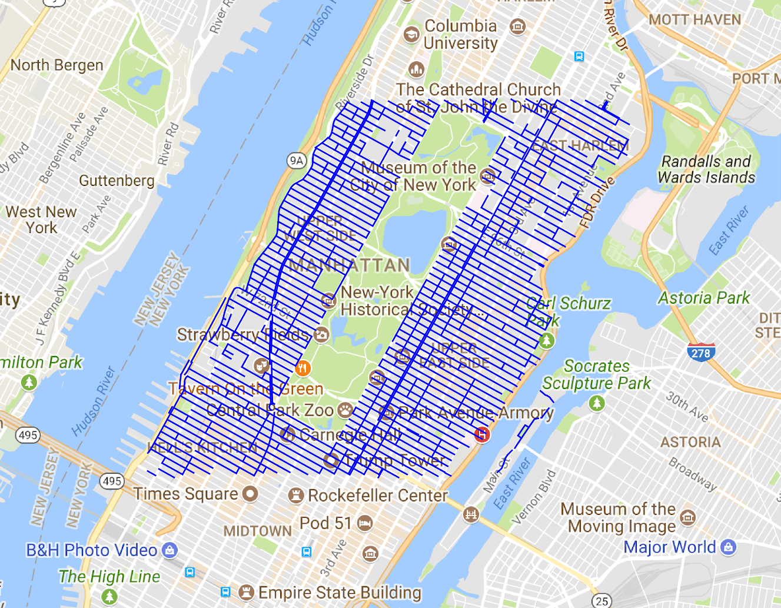
Centerline Dataset

Slide 7
Parking Tickets
All parking tickets in NYC between 2014-2018
10+ Million rows:
Street and house number
Date and time
Violation Code
Meter Number

Slide 8
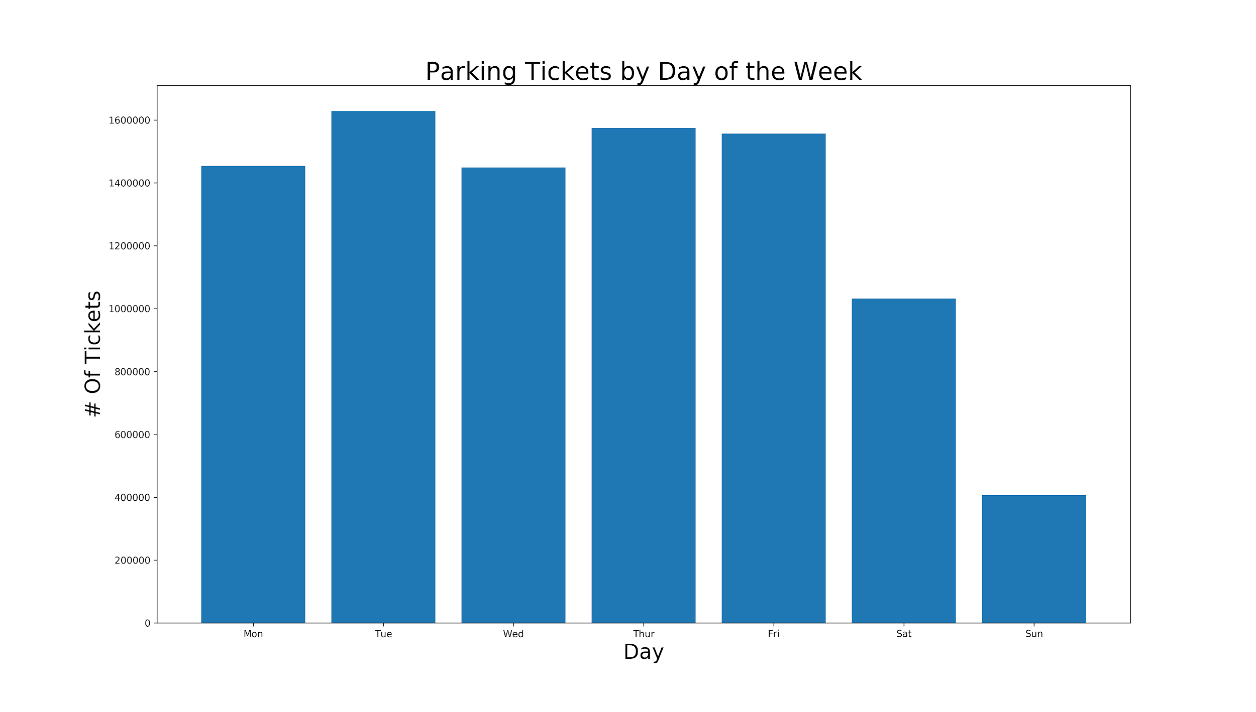
Parking Tickets

Slide 9
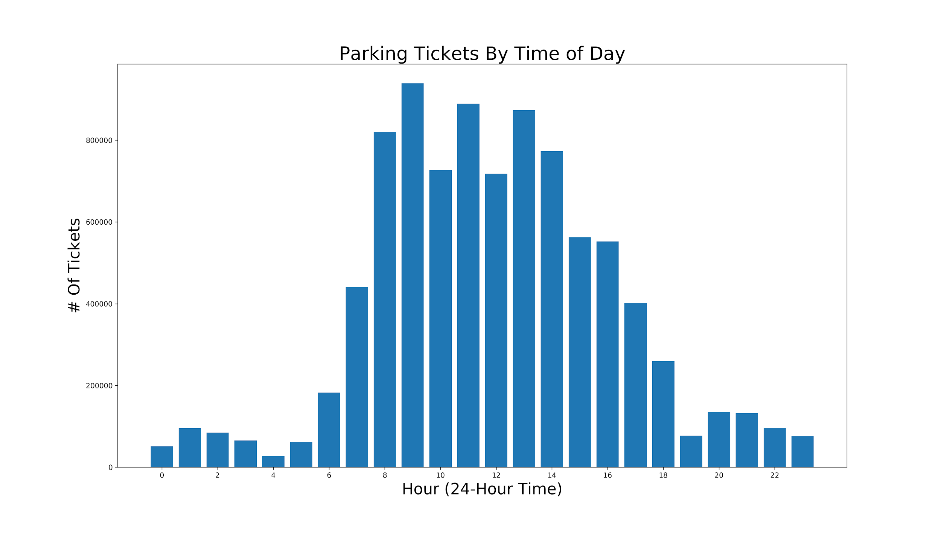
Parking Tickets

Slide 10
Parking Tickets + Centerline
Joined datasets by matching street names and house numbers.
Map tickets down to latitude/longitude
Aggregate to number of tickets on a certain street

Slide 11
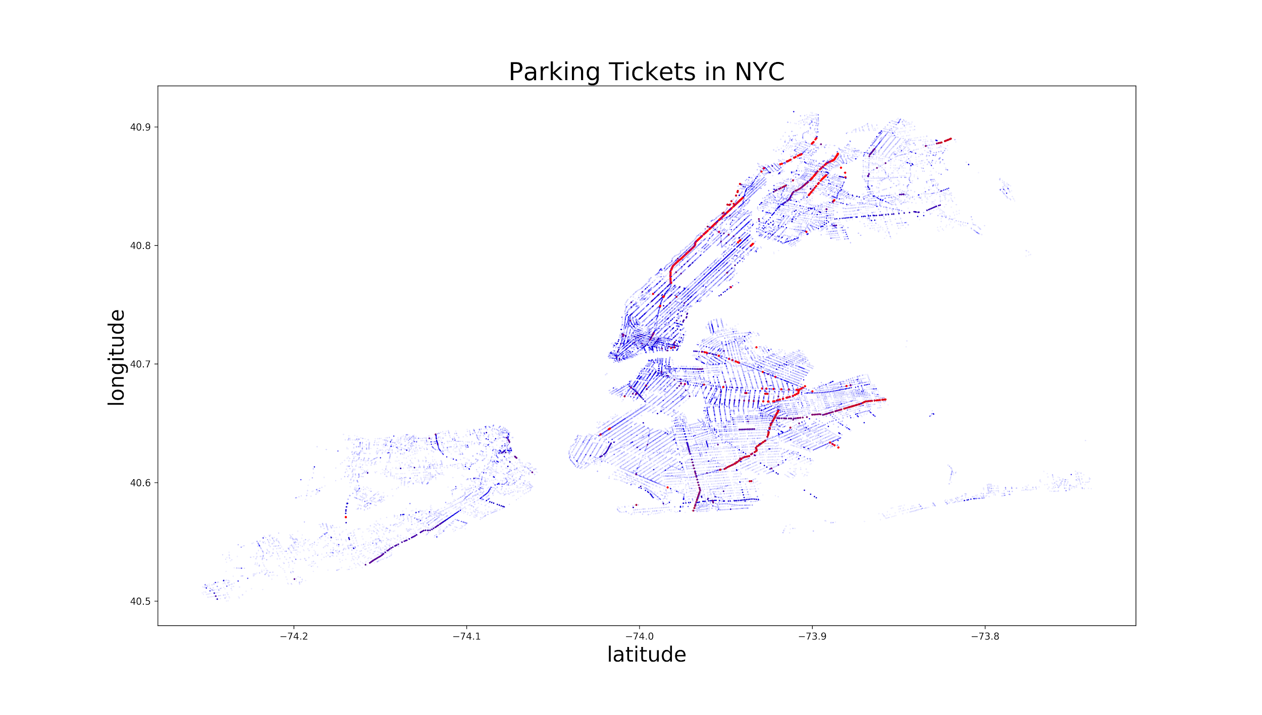
Parking Tickets + Centerline

Slide 12
Parking Tickets + Centerline

Slide 13
Google Maps API
Overlay data points on a map of NYC
Advanced Visualizations:
Scatter plots
Heatmaps/Density plots

Slide 14
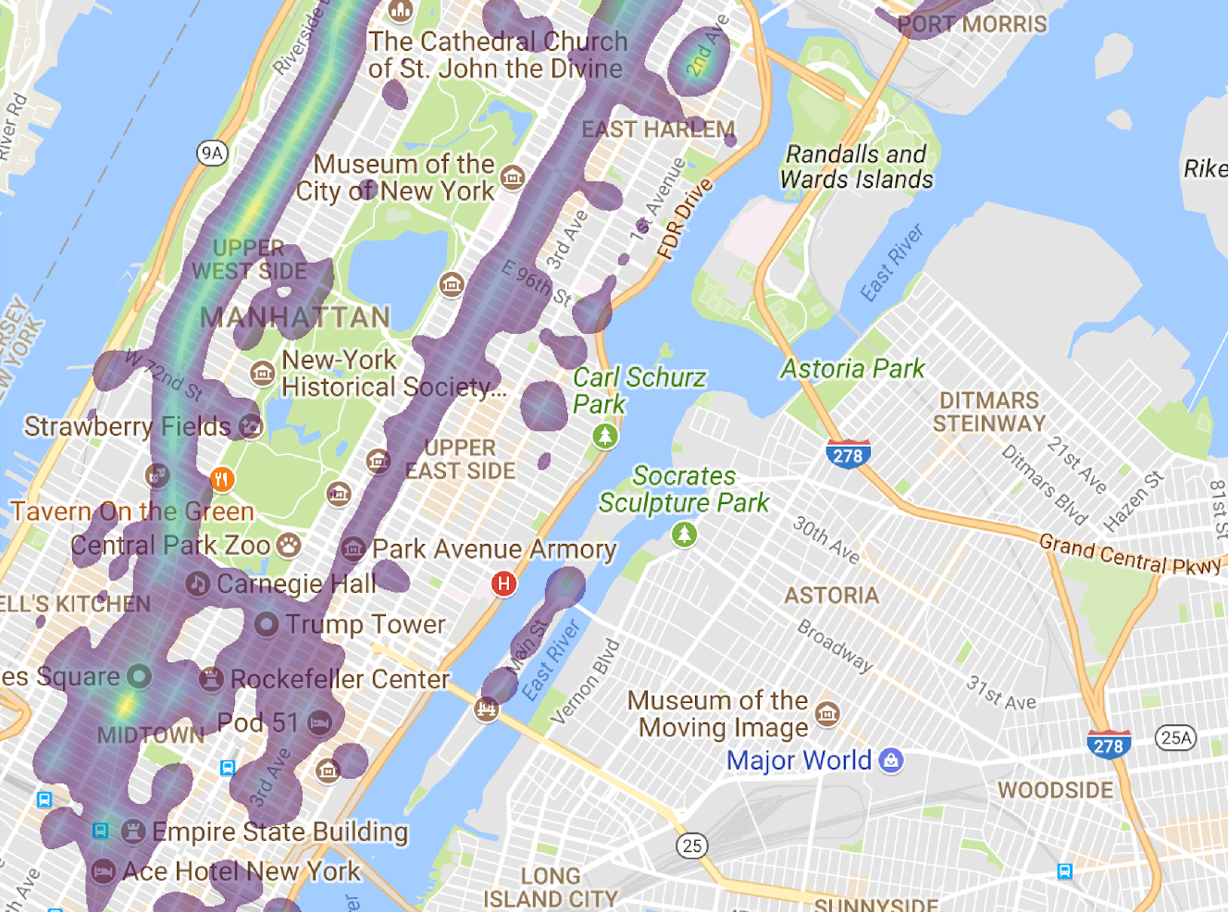
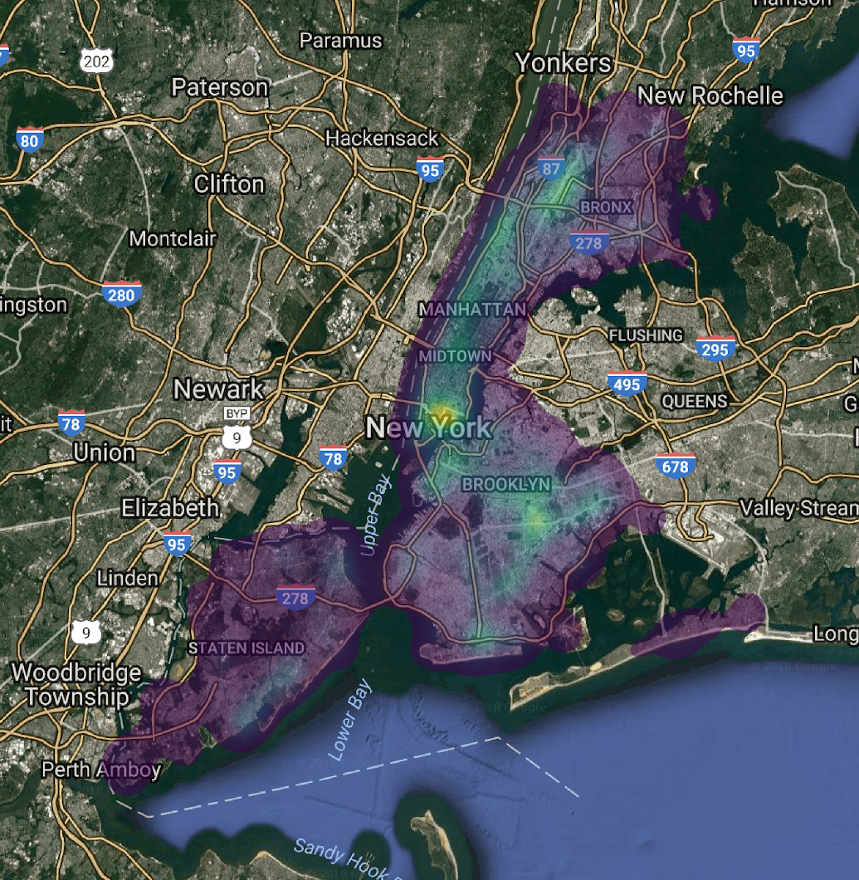
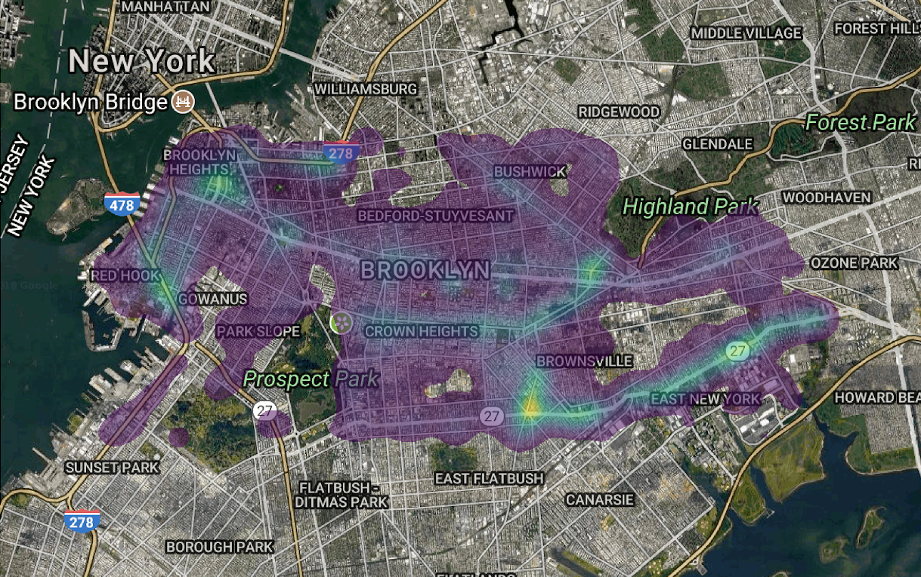
Google Maps API

Slide 15
Parking Meters Dataset
15,000+ Parking Meters
Latitude/Longitude
Meter Number

Slide 16
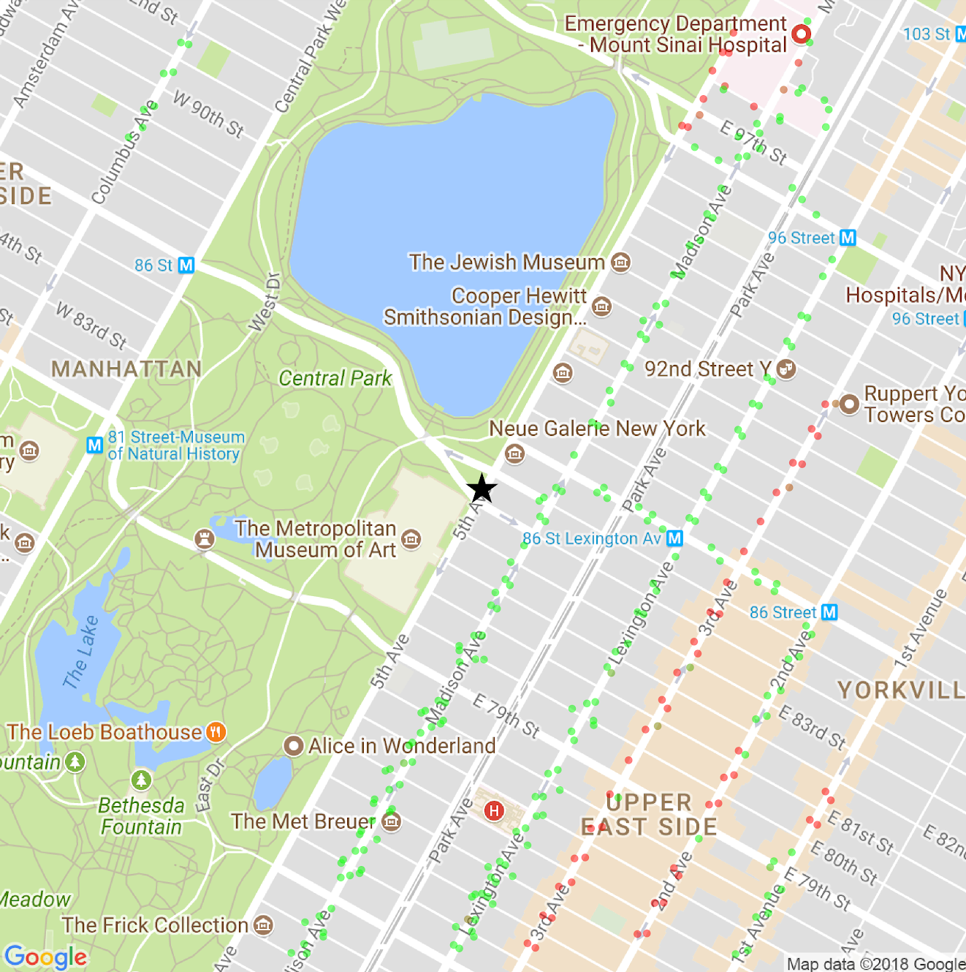
Application
Locate Meters near you that are less likely to be checked by ticket officers

Slide 17
Taxi Data
Roughly 10+ Million Rows per month
Some of the more notable columns include the pickup and dropoff longitudes, latitudes, and times, trip distance, number of passengers, and fare amount
Size totaled to about 20GB per year

Slide 18
Processing Taxi Data - Overview
SparkSQL to process rows
SparkSQL made it especially easy to manage things like time because of the datetime format, allowing me to access month, hour, year, etc
Made grouping, aggregating, and ordering by one or more columns incredibly simple

Slide 19
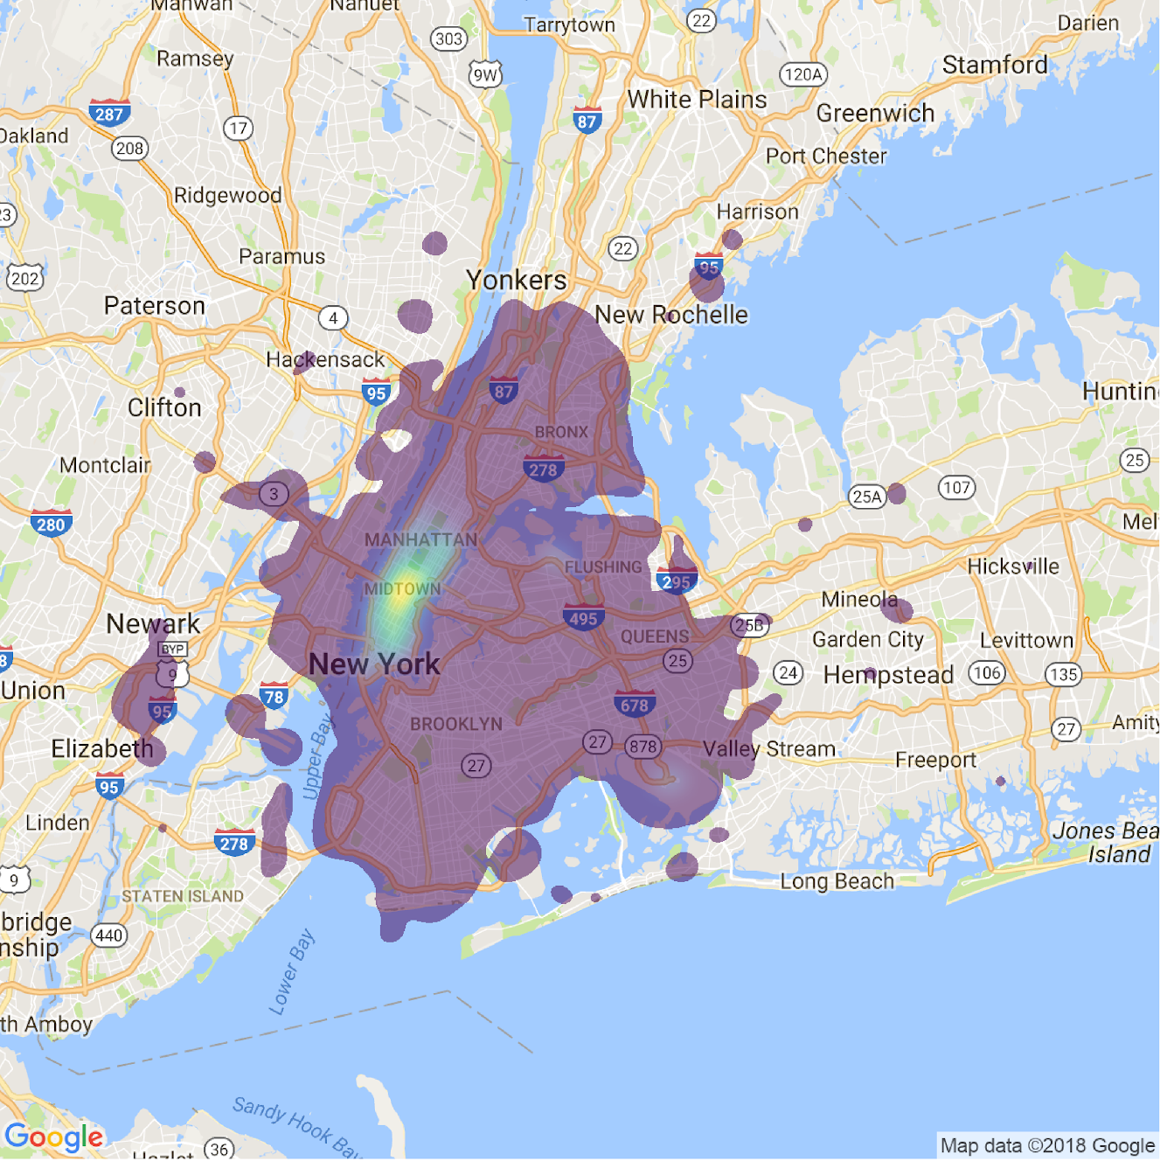
Taxi Data
Taxi pickup
locations before
9 am

Slide 20
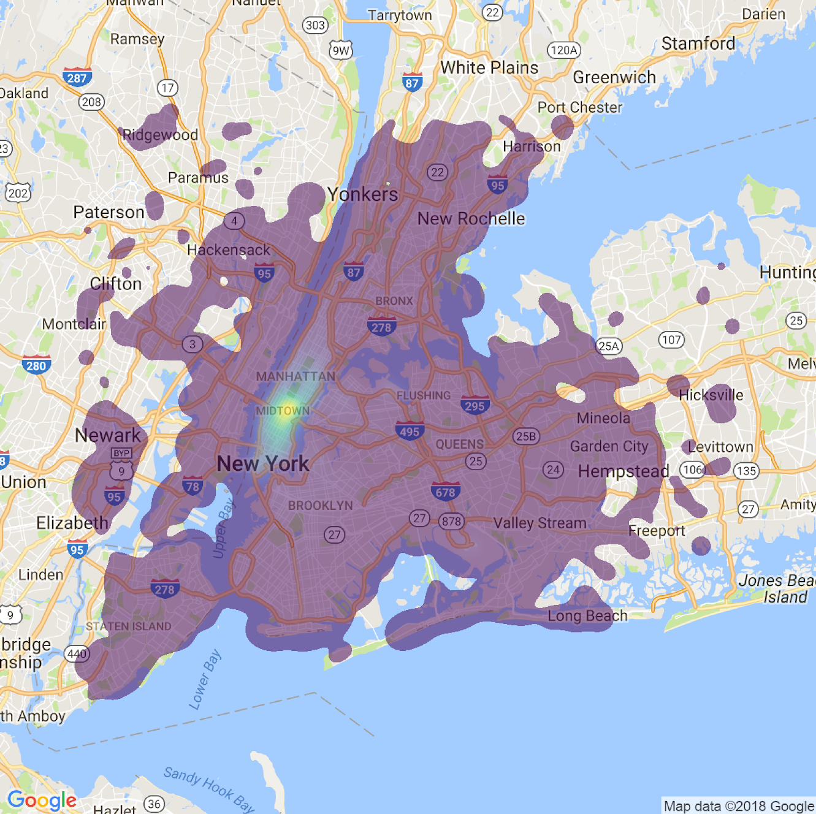
Taxi Data
Taxi drop off locations before
9 am

Slide 21
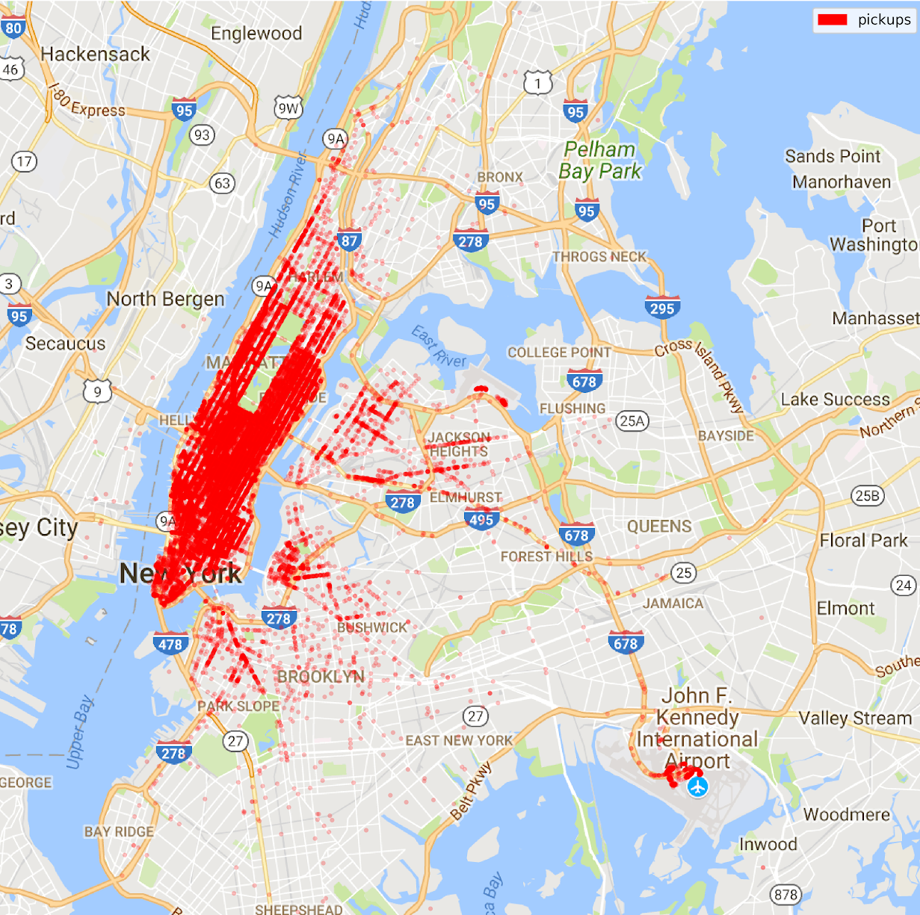
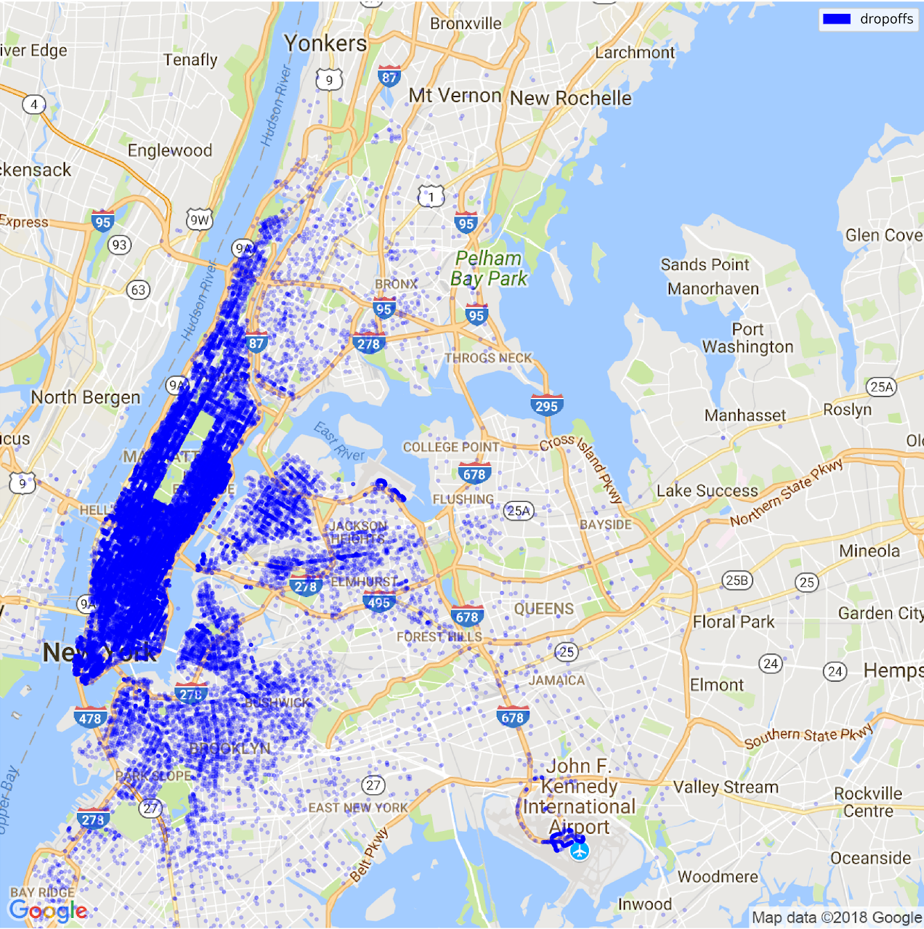
Taxi Data

Slide 22
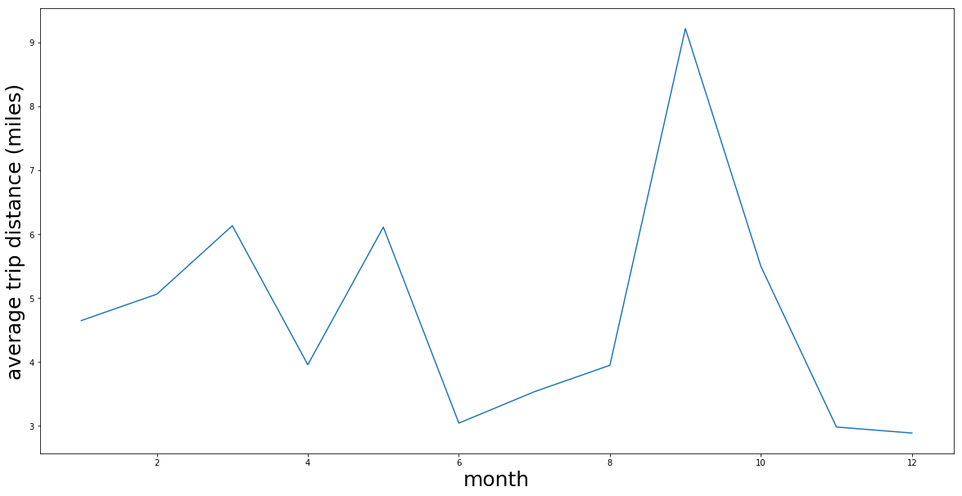
Taxi Trips Over Time
Trends based on years and seasons

Slide 23
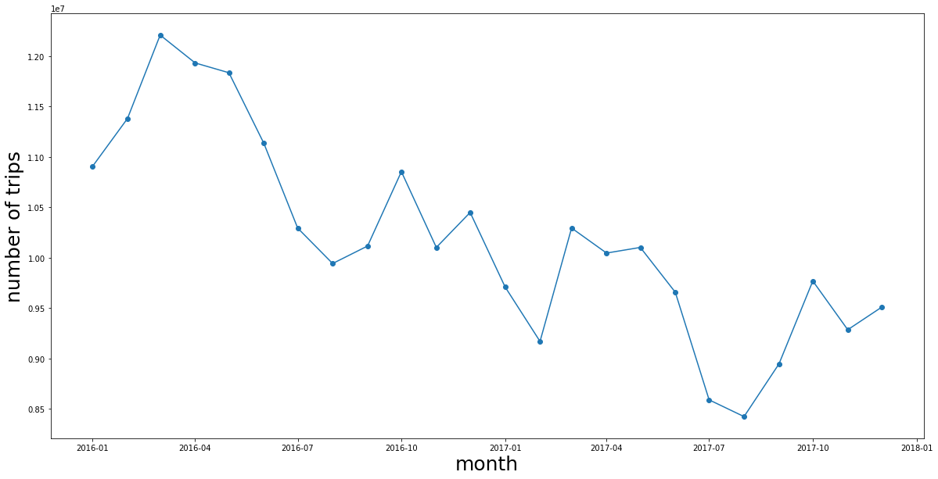
Decline of Taxis over the years
The data suggests a reduction in the total number of trips throughout the years, largely attributed to the rise of uber

Slide 24
NYC Bike Dataset
Pickup/dropoff station, time of day, etc. for every single city bike
2014 - present
Misaligned formats/corrupted files
>60 GB in total

Slide 25
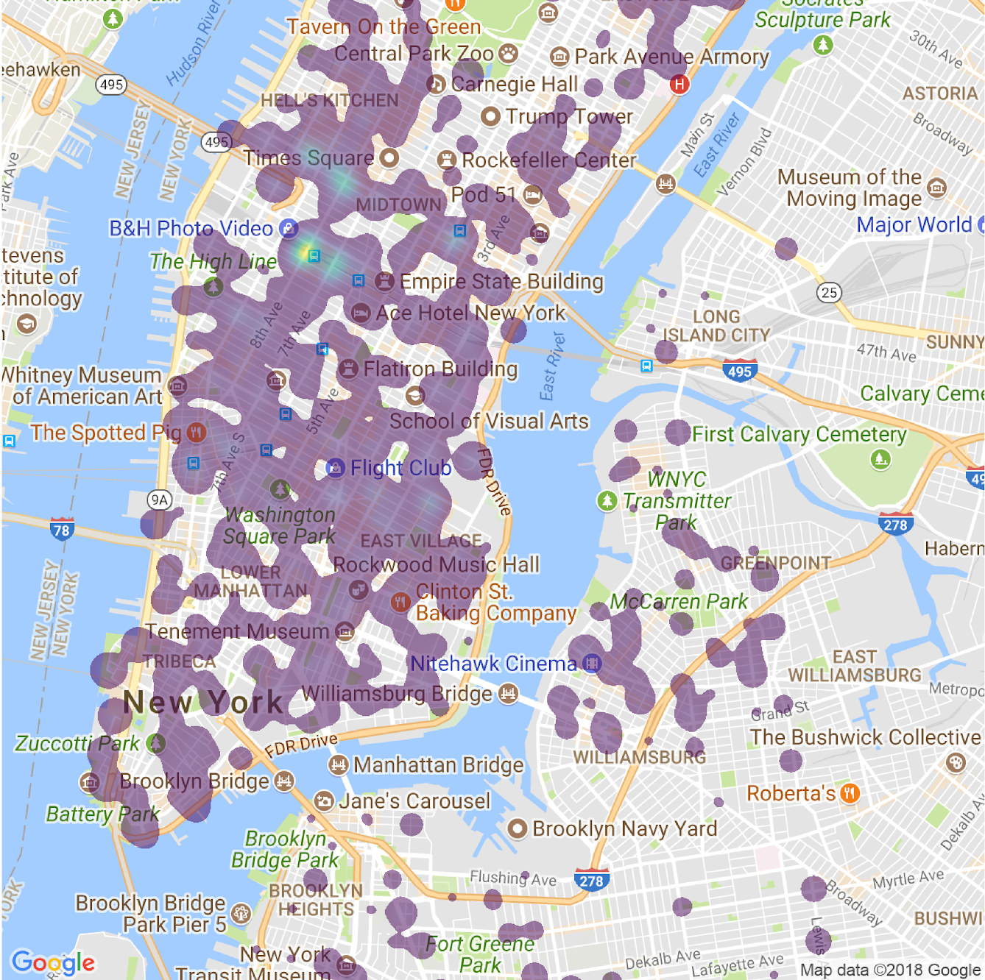
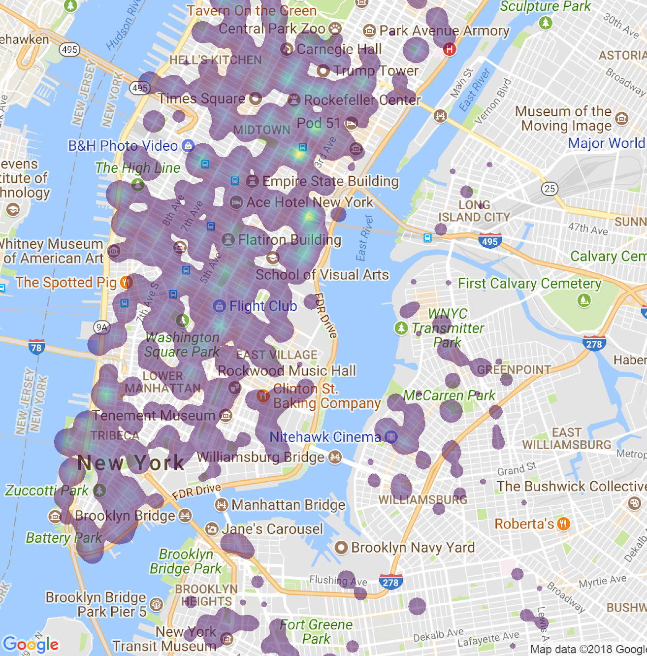
Morning Bikes
Bike Pickups
Bike Drop offs
Visualization 1

Slide 26
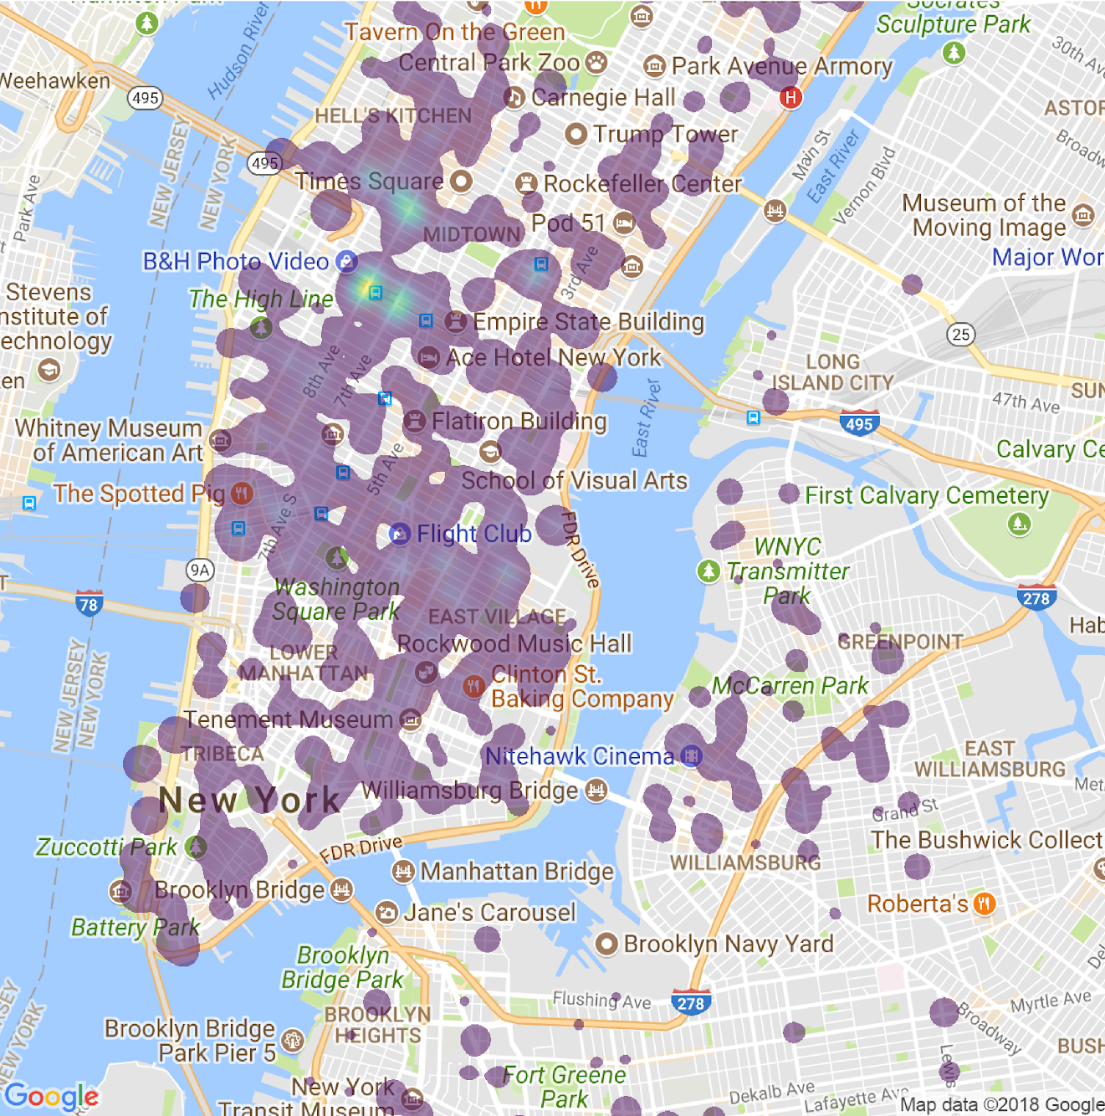
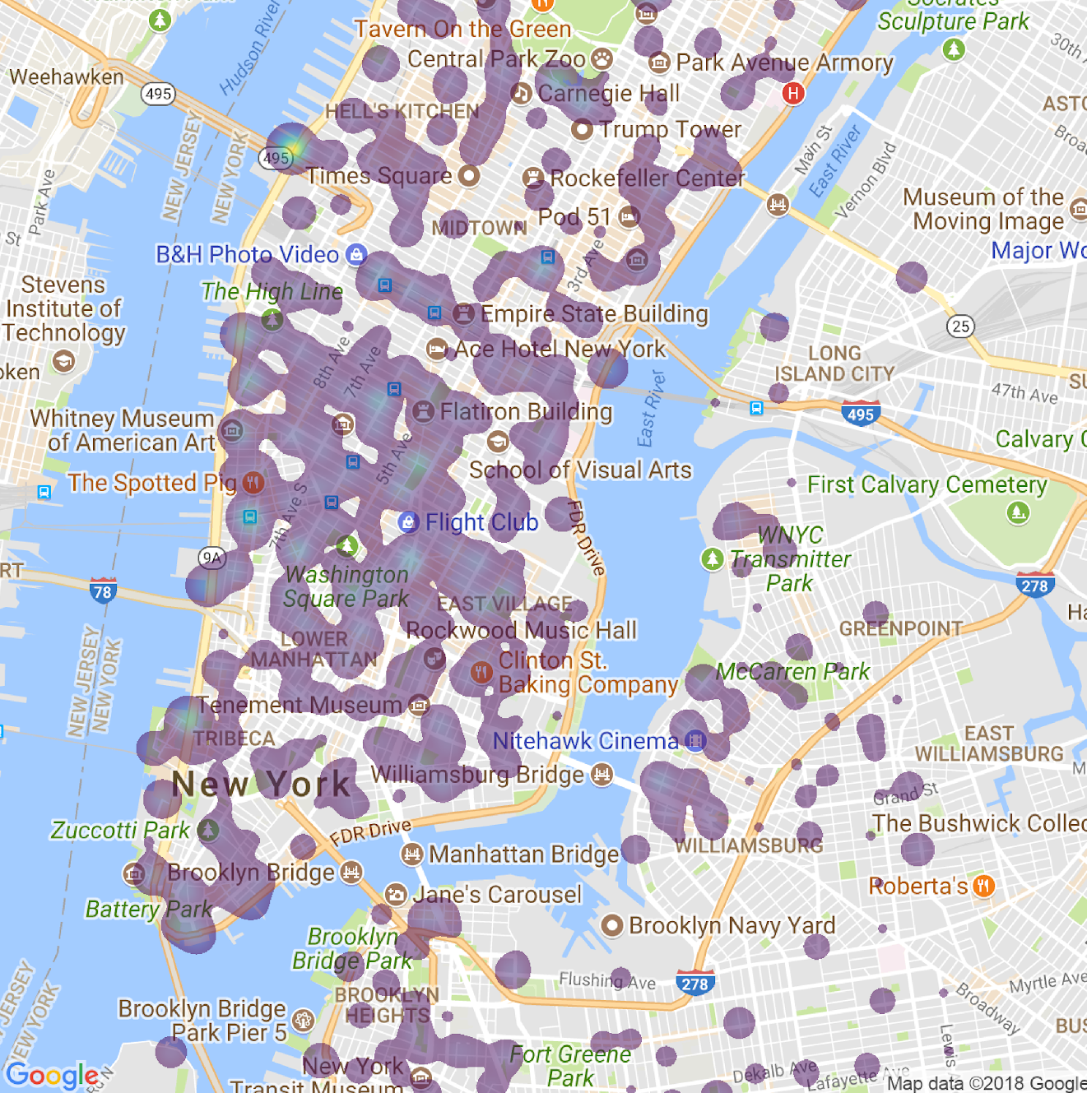
Evening Bikes
Morning
Evening
Visualization 2

Slide 27
Taxi Linear Regression
Predict fare amount based off pickup latitude and longitude, and dropoff latitude and longitude
Used K-Means Clustering to place pickup points into regions (K=20)
Linear Regression predicts fare amount from region (R^2 = 0.8)

Slide 28
Sources
data.cityofnewyork.us/
citibikenyc.com/system-data
nyc.gov/html/tlc/html/about/trip_record_data.shtml

